Slide 1
Predicting Movie Revenues Using Linear Regression
Integrating Fast API for Model Predictions and Visualizations

Slide 2
Introduction
In this project, we develop a predictive model to estimate movie revenues using a linear regression algorithm. The goal is to understand how variables such as budget, runtime, and popularity impact box office performance. To achieve this, we first preprocess and clean the dataset, then train and evaluate a linear regression model. Finally, we use Fast API to create a web service that allows users to input movie attributes and receive revenue predictions, along with visualizations to assess model accuracy and performance.

Slide 3
Dataset Overview
The dataset used for this project is the movies_metadata.csv, which contains various attributes related to movies. Key columns of interest include budget, revenue, runtime, and popularity. The dataset provides financial and runtime details of movies, which are crucial for understanding their box office performance. We focus on these specific attributes as they are likely to have a significant impact on revenue, allowing us to build a model that can predict future revenues based on these factors.

Slide 4
Data Pre processing
Data preprocessing is a critical step in ensuring the quality and accuracy of our model. We start by loading the dataset and converting columns such as budget, revenue, runtime, and popularity to numeric types to handle any non-numeric values and errors.
Next, we select only the relevant columns for our analysis and remove any rows with missing values to ensure a clean dataset.
This step is essential for building a reliable model, as missing or incorrect data can lead to inaccurate predictions and skewed results.

Slide 5
Feature Selection
For our linear regression model, we define three features: budget, runtime, and popularity, which are used to predict the target variable, revenue. The choice of these features is based on their potential influence on a movie’s revenue.
By splitting the data into training and testing sets, we train the model on the training data and evaluate its performance on the testing data.
This approach helps in assessing how well our model generalizes to new, unseen data and ensures that our predictions are reliable

Slide 6
Model Training
We utilize the Linear Regression algorithm to train our model, which aims to find the best-fit line that predicts movie revenue based on the input features. The model is trained using the training set,
where it learns the relationships between the features (budget, runtime, and popularity) and
the target variable (revenue). Once trained, the model can be used to make predictions on the testing set, providing us with an understanding of its predictive capabilities and performance.

Slide 7
Model Evaluation
To evaluate our model's performance, we use two key metrics: Mean Squared Error (MSE) and R-squared (R²). MSE measures the average squared difference between predicted and actual values, giving us an indication of prediction accuracy.
R² represents the proportion of variance in the target variable that is explained by the model, with higher values indicating better performance. By analyzing these metrics,
we assess how well the model performs and identify areas for potential improvement.

Slide 8
Fast API Integration
Fast API is used to create a web service that provides interactive access to our predictive model. This integration allows users to input movie attributes and receive revenue predictions in real-time. We define several endpoints in our Fast API application,
including /predict for making revenue predictions and /plot/actual_vs_predicted and /plot/residuals for generating visualizations of model performance.
This setup not only makes the model accessible to users but also enhances its usability by providing visual insights.

Slide 9
Predict Revenue
The /predict endpoint in our Fast API application accepts input data in the form of a JSON object with attributes budget, runtime, and popularity.
Using this input, the endpoint prepares the data for prediction and utilizes the trained linear regression model to estimate the movie's revenue.
The result is then returned to the user as a JSON response, providing a straightforward and efficient way to obtain revenue predictions based on the provided movie attributes.

Slide 10
Actual vs Predicted Plot
The /plot/actual_vs_predicted endpoint generates and serves a plot comparing actual revenue values to predicted revenue values. This scatter plot visually represents the performance of our model, showing how closely the predictions align with actual values. A line of equality is included to indicate where predictions perfectly match actual values. This visualization helps in assessing the model's accuracy and identifying any systematic errors or biases in the predictions.
Residuals Distribution Plot
The /plot/residuals endpoint creates and serves a plot of the residuals, which are the differences between actual and predicted revenue values. This histogram with a kernel density estimate (KDE) provides insight into the distribution of prediction errors. Analyzing the residuals helps in evaluating the model’s performance by revealing patterns or inconsistencies that may indicate areas for improvement. Ideally, residuals should be randomly distributed without any discernible patterns.

Slide 11
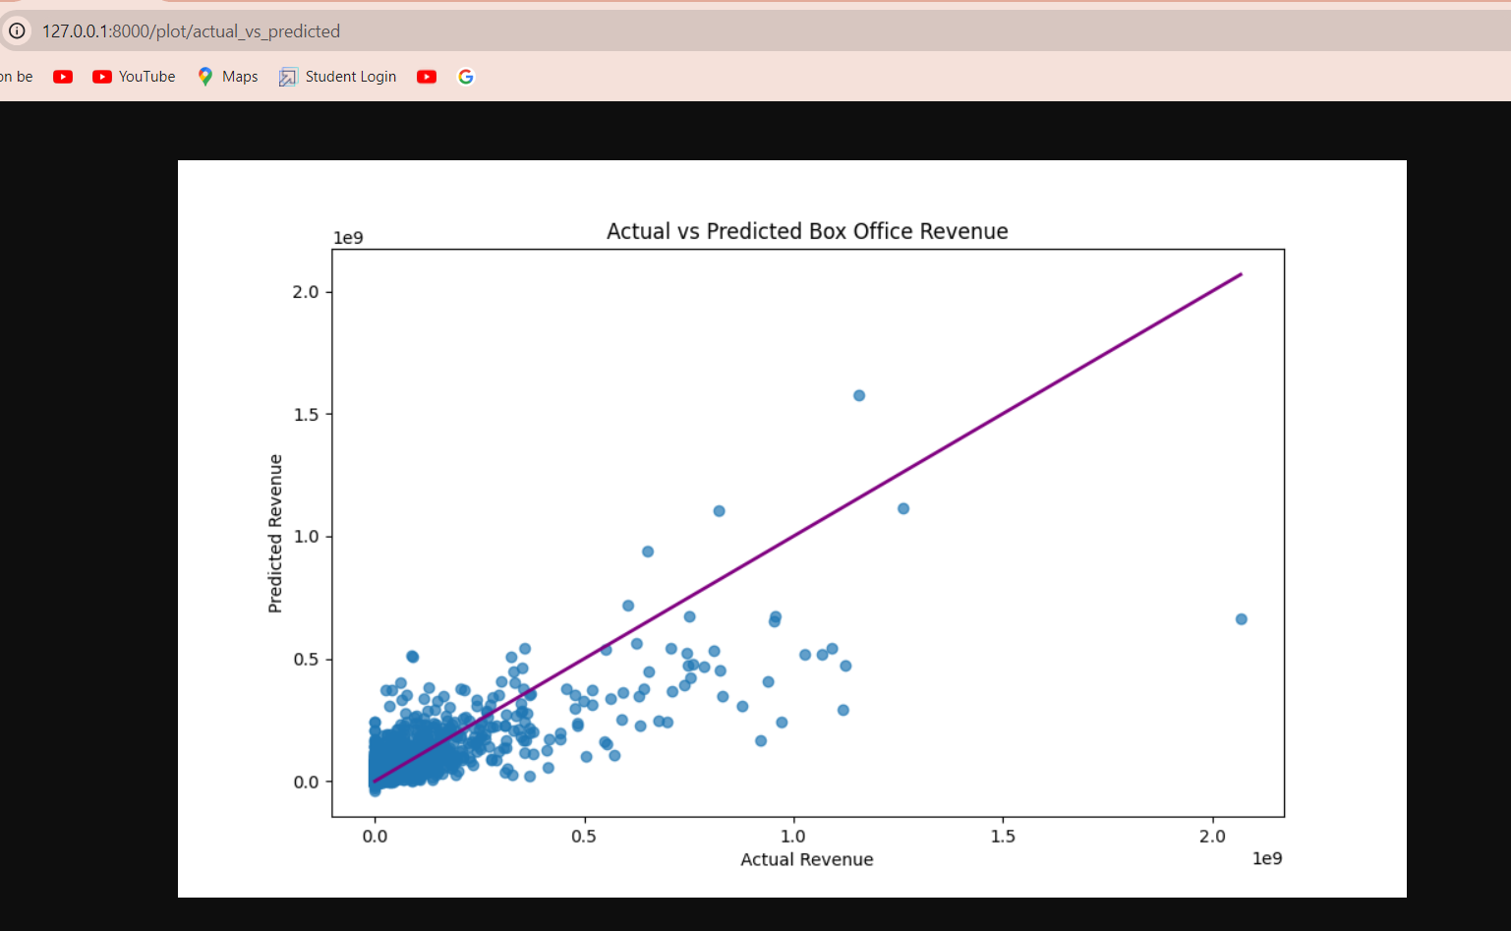

Slide 12
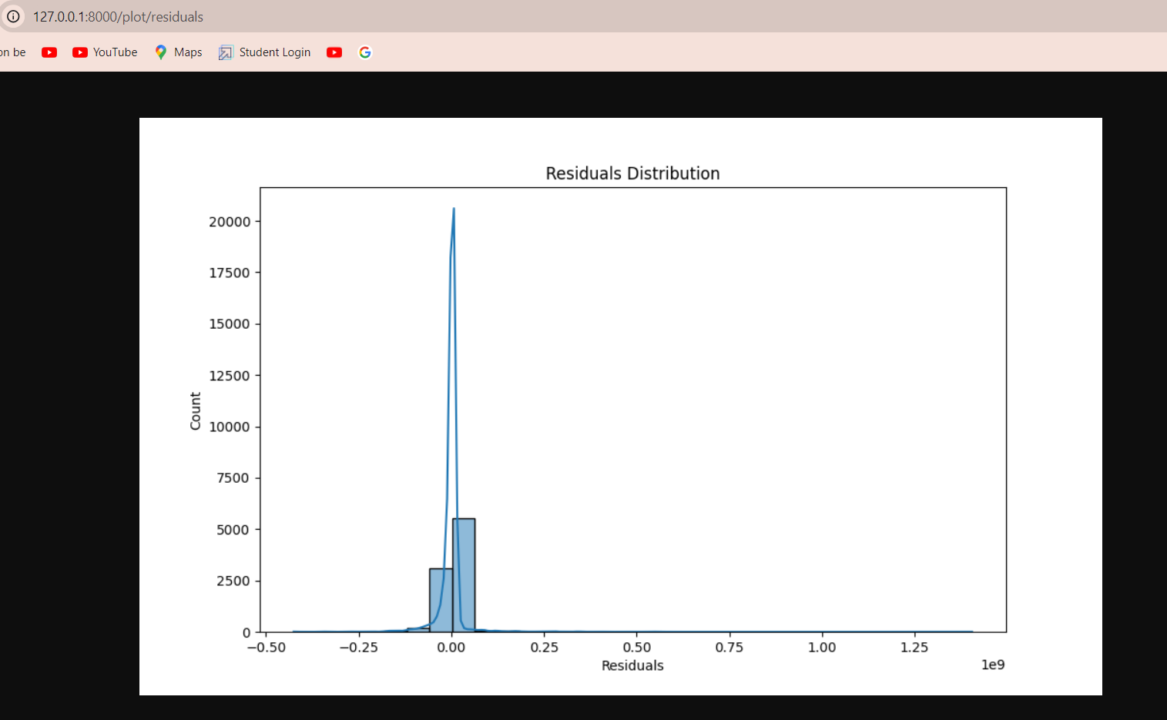

Slide 13
Visualizations
The visualizations generated by the Fast API endpoints provide valuable insights into the model's performance. The "Actual vs Predicted" plot helps in visually assessing how well the model's predictions match actual revenue values. The "Residuals Distribution" plot offers an understanding of the distribution of prediction errors, highlighting any systematic issues with the model. Including these plots in the presentation illustrates the model’s effectiveness and areas where it may need refinement.

Slide 14
Conclusion
In conclusion, this project demonstrates how linear regression can be used to predict movie revenues based on key features such as budget, runtime, and popularity. By integrating FastAPI, we create a user-friendly web service for making predictions and generating performance visualizations. The model's performance is evaluated through metrics like MSE and R², and visualizations provide additional insights into its accuracy. Future work could involve exploring more complex models, incorporating additional features, or deploying the web service in a production environment

